Slide 2
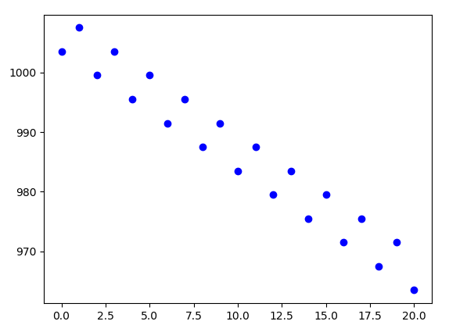
Case study 1 : overview
Time_series_forecasting.py
Training set
  Alternation of +4 and -8
  starting at 2000
  Size : 200
Testing set identical
  Generated separately
  Different starting point or not
  Size : 20

Slide 3
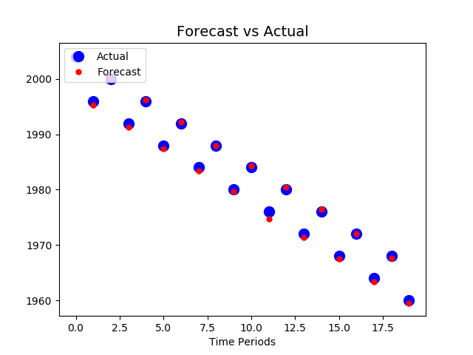
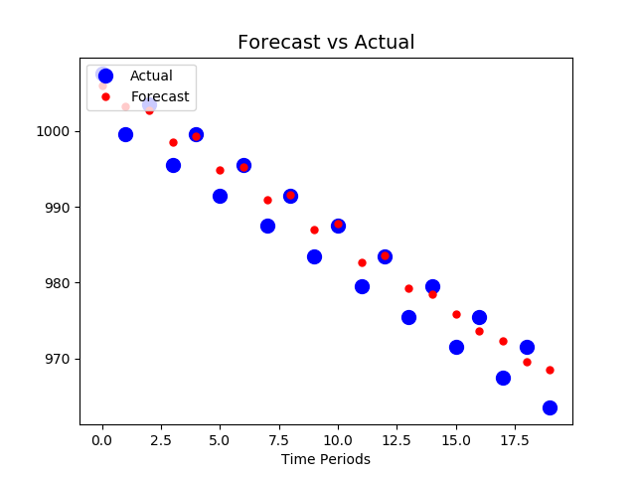
Case study 1 : experimental part
SP : 2000
SP : 1003.5
After slight adaptation of tutorial’s script, rather good result. However,
- Sometimes, tendency to « draw a line between dots »
- Sensitive to starting point (overfitting?)

Slide 4
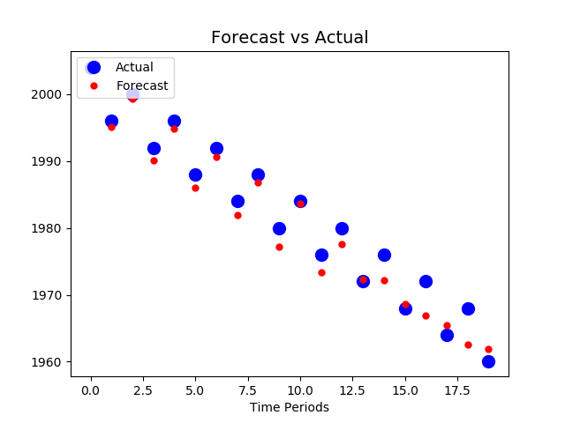
Case study 1 : experimental part
Two successive runs of same script leads to different results…
- model optimization for lower error

Slide 5
Model architecture
Recurrent neural network
1 input = 20 period-long vector
1 hidden layer (100 neurons)
1 output = forecasting at t+1

Slide 6
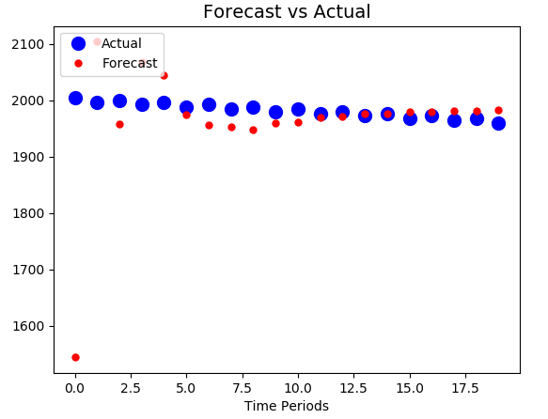
10 neurons

Slide 7
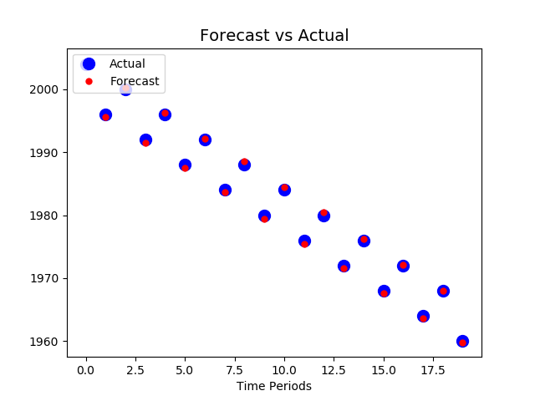
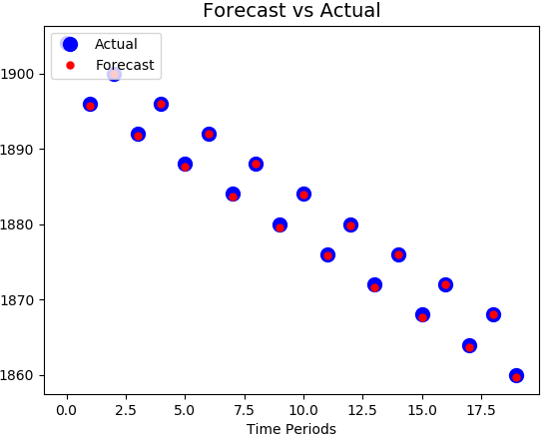
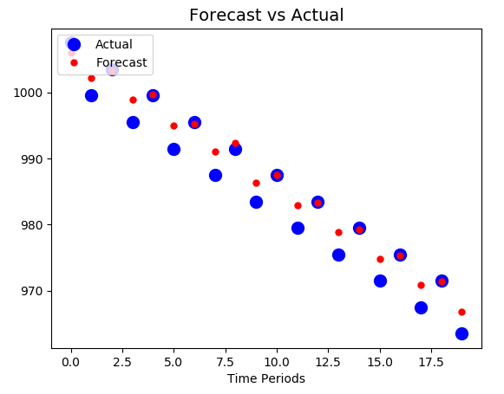
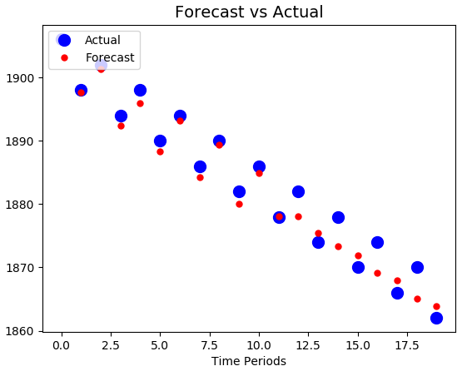
Case study 1 : experimental part
2000 and 1900 belongs to the training dataset… 1003.5 and 1902 do not → clearly overvitting

Slide 8
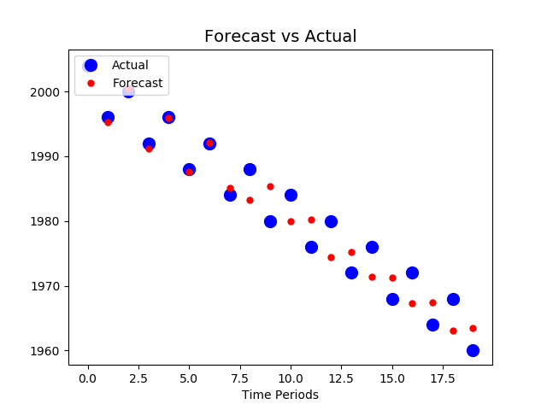
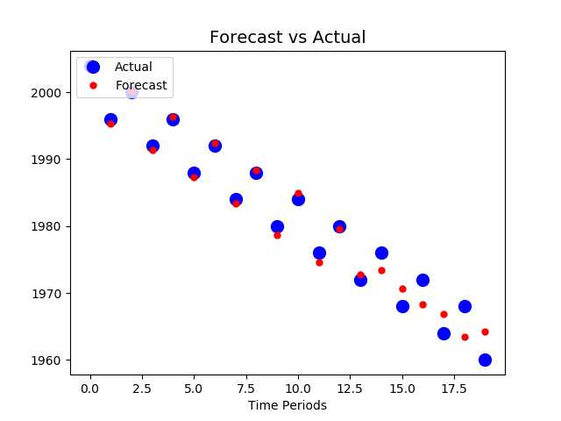
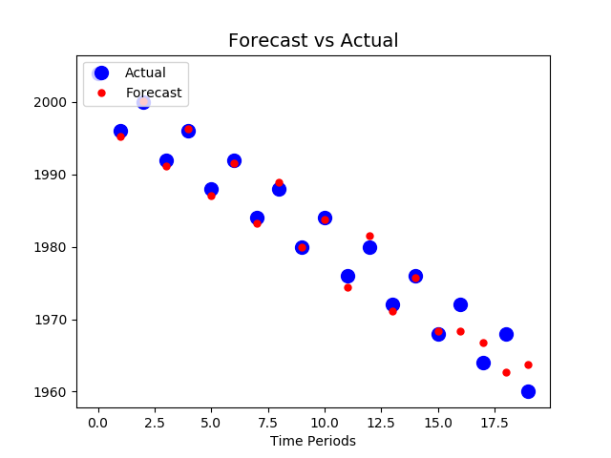
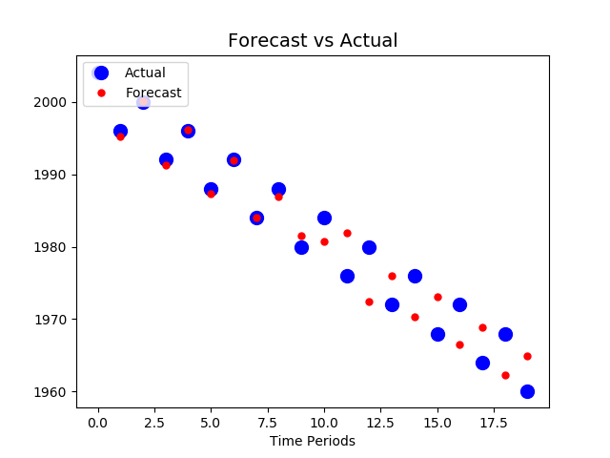

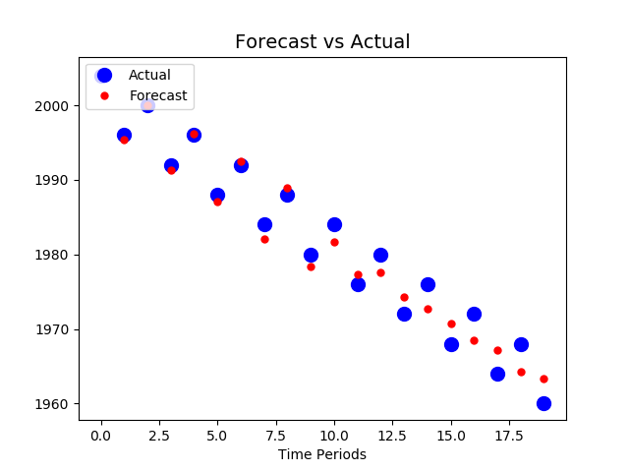
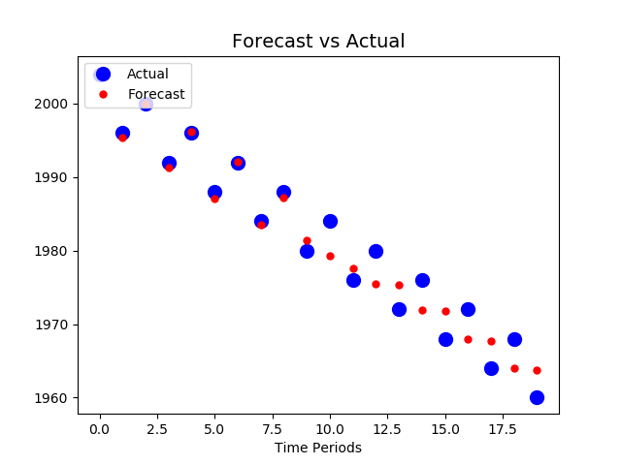
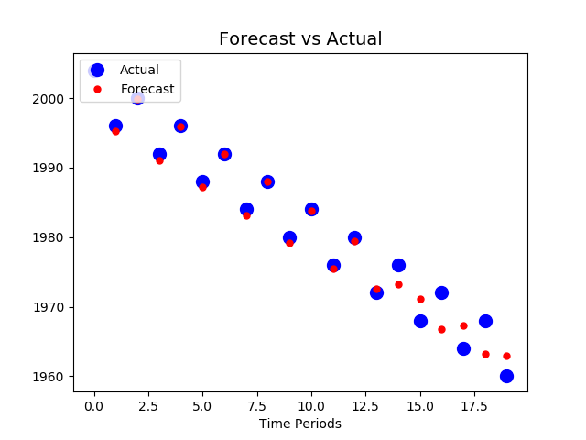
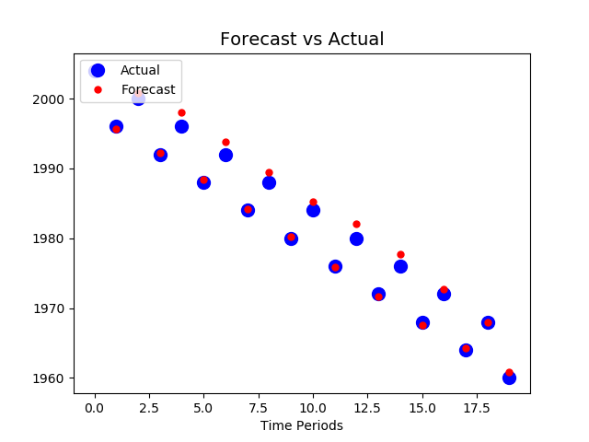
50 neurons
100 neurons
200 neurons

Slide 9
Training from 2000
Starting from 1003.5...

Slide 10
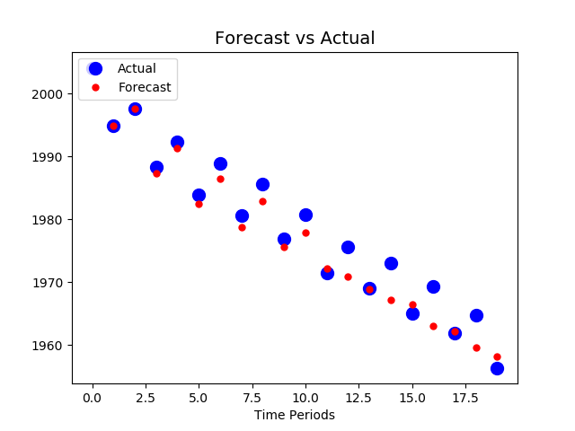
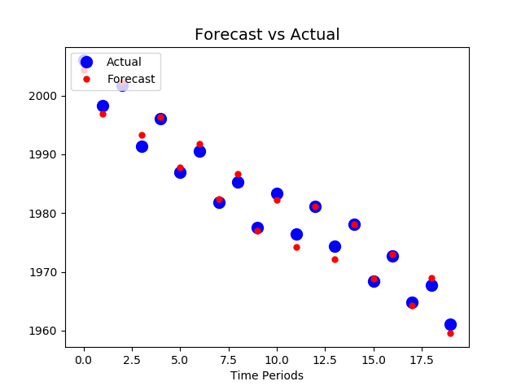
Noise applied to test data, apply noise to prevent overfit

Slide 11
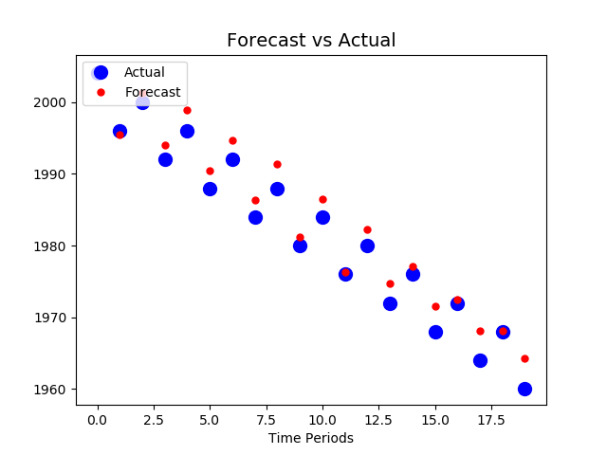
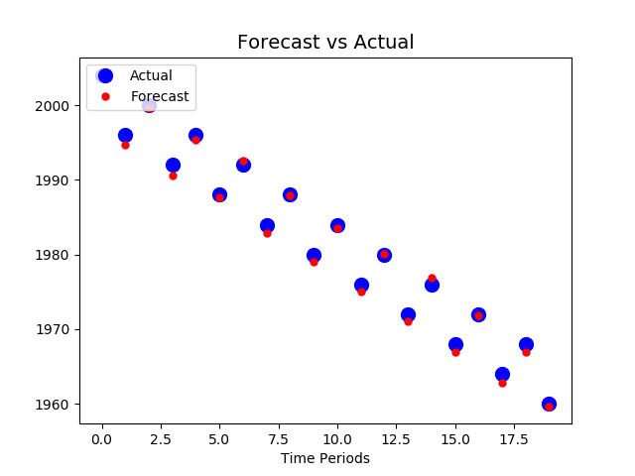
Noise applied to train data
Mmmh, is the first point around 2000 more noised on the right ?

Slide 12
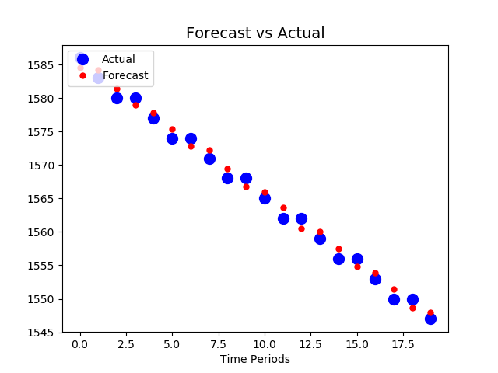
Other patterns...

Slide 13
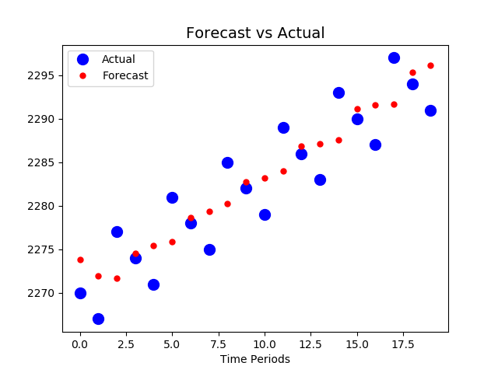
Other patterns...

Slide 14
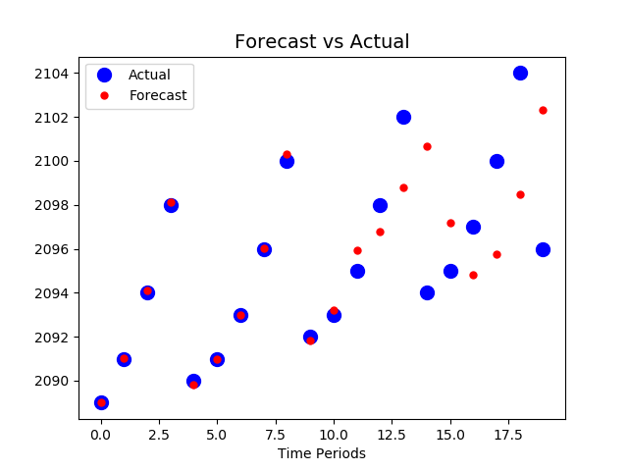
Other patterns...
if np.mod(y,5) == 0:
price[y] = price[y-1] - 8
else:
price[y] = price[y-1] + np.mod(y,5)

Slide 15
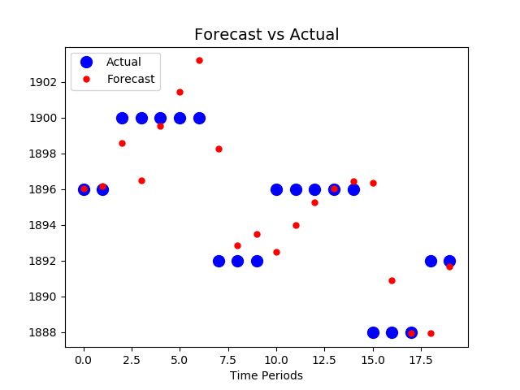
Other patterns...
if np.mod(y,8) == 0:
price[y] = price[y-1] - 8
elif np.mod(y,8) == 3:
price[y] = price[y-1] + 4
else:
price[y] = price[y-1]

